Slide 1
National Early Years Summit
11 – 12 March 2020
The Pullman Hotel Melbourne
https://early-years.com.au

Slide 2
Intended impact
By 2030 more Australian children will thrive in the first 1000 of their lives and beyond

Slide 3
Day 1 morning panel – “What is working for children that we need to do more of?”
Address the inequality of access for all children (Prof Sharon Goldfeld)
Ensure children with disability have equitable access to the NDIS (Kerry Bull)
Early education needs to be ‘planned, purposeful and playful’ with education to be regular and systematic (Sue Robb)
A home environment that is secure, providing education and support for parents too (Jane Fisher)
Ensure our system recognises and reflects all views (western and indigenous) (Alison Wunungmurra)
In summary, programs work when they come from a ‘children’s space’ not a ‘work space’

Slide 4
Day 1 afternoon panel: If I wrote the blueprint, it would say…
The blueprint needs to be:
Population-based: progressive, not stigmatised, supports where families are (Prof Daryl Higgins)
Prevention-focused: consider risk factors, look at history and parents early needs, provide hand in hand platform (Prof Daryl Higgins)
Partnership-based: trusted relationships, regular engagement (Prof Daryl Higgins)
Practice-aligned: work in a different space (Prof Daryl Higgins)
Provide a system that supports First Nation people, listen to First Nation advocates (Lisa Thorpe)
Question the quality of policies in place (Peter DeNatris)
Consider what families need to thrive (Peter DeNatris)
A business and social purpose to drive system change (Michael Traill)

Slide 5
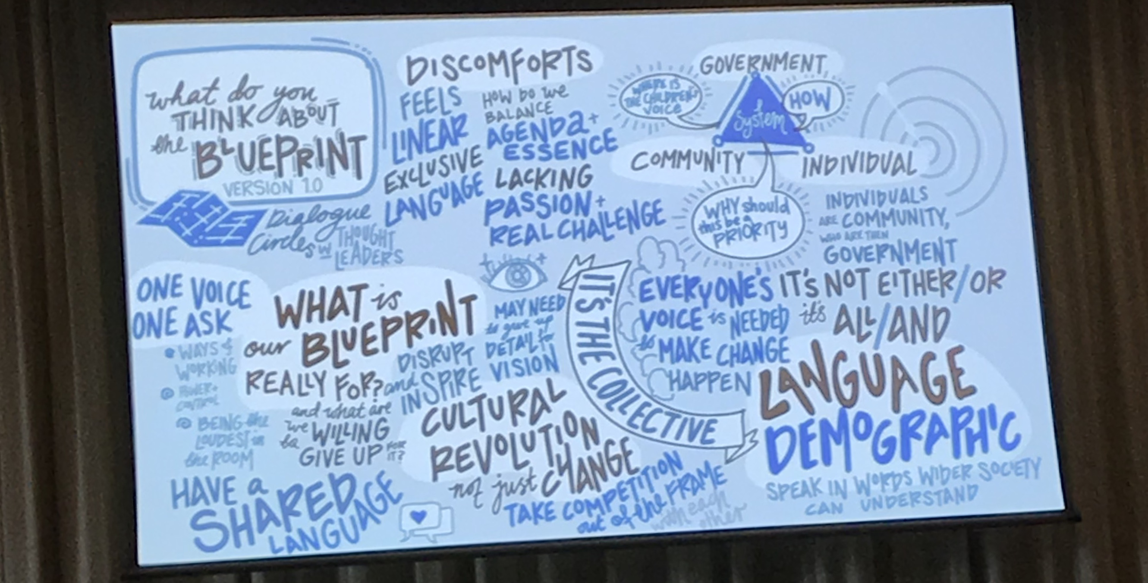
The Blueprint

Slide 6
Day 2 Morning Panel: What’s missing from the Blueprint – PASSION!
We need more moral outrage, more anger (Richard Weston)
Make children visible (Richard Weston)
Bring a transformative vision (Kristy Nolan)
Growth pathway must start with children (Tony Stuart)
No Human Rights Statement in the Blueprint
Need integration of mental health and diversity in Blueprint
Blueprint needs to empower people
Make this everyone’s business

Slide 7
Day 2 Afternoon panel: Blueprint 2.0
What has come out of the summit?
Outrage that children are not protected
Provide ‘enabling infrastructures’
Include First Nations narratives – “rich conversations but little action”
Data as a powerful tool
Family-centred practice is the best form of support
We need to lead change and show the government what we CAN DO
This is a summary of points from Kerry Graham, Terri Soller, Penny Deakin, Sue West, Dr Brian Babington, Maria Stuart, Dr Barb Vernon, Professor Jeanette Milgrom AM

Slide 8
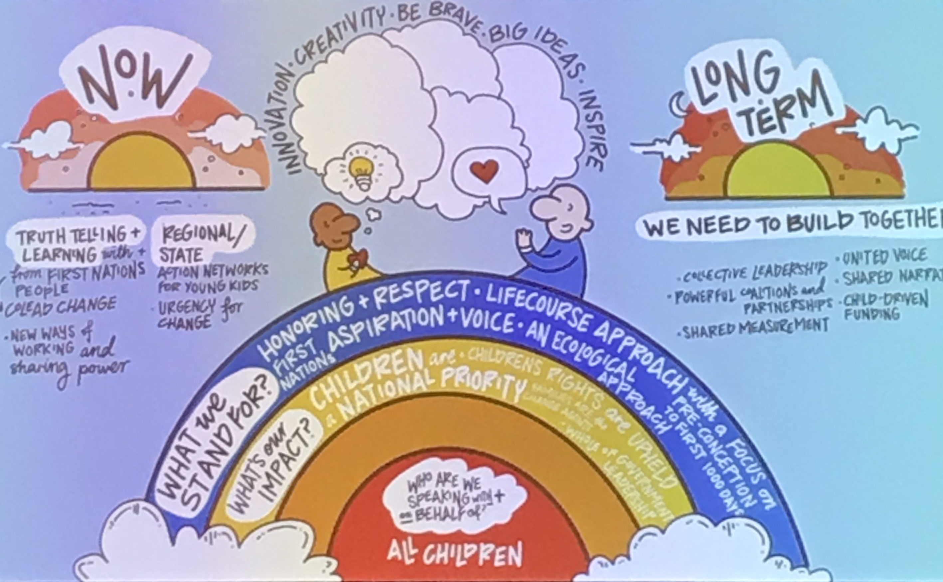

Slide 9
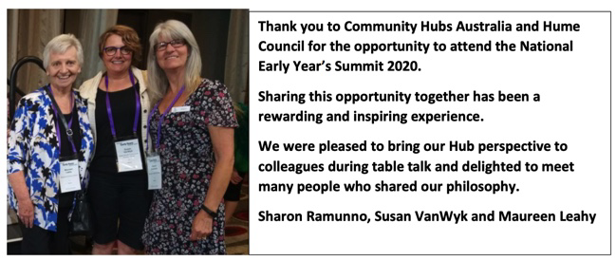
Thank you!

